Slide 1

PROOF OF CONCEPT
GAUTHIER FALISE
GRÉGOIRE DESFOSSE
ESILV A4

Slide 2
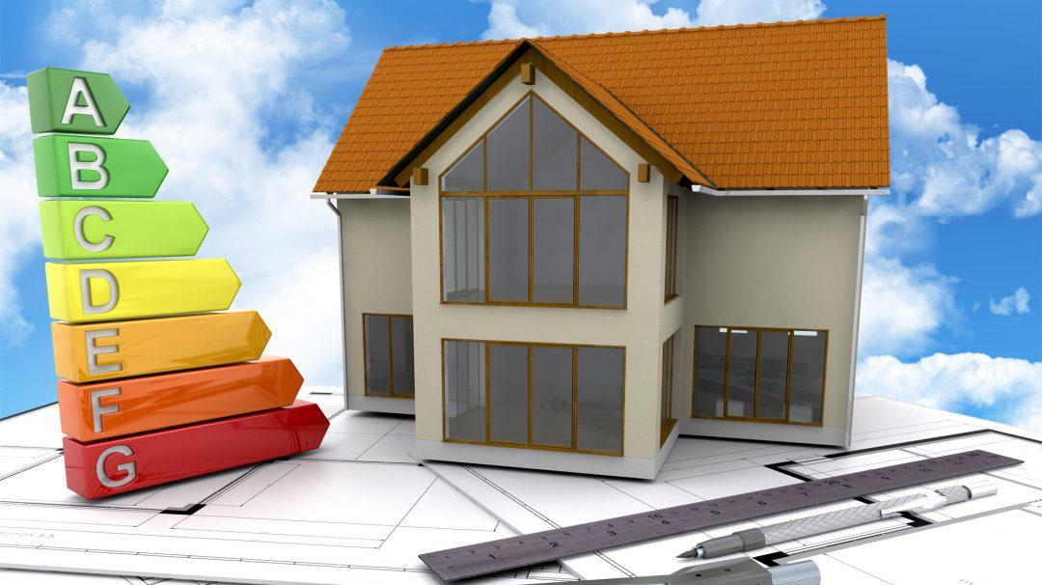
TABLE OF CONTENT
Our approach
Which problem ?
Which solutions ?
Our solution
First prototype
To go further

Slide 3


OUR APPROACH
“L’efficacité énergétique est au centre des préoccupations actuelles du bâtiment.”
Marc Fitoussi, Architecte D.P.L.G.

Slide 4
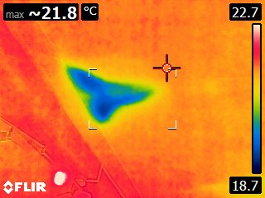
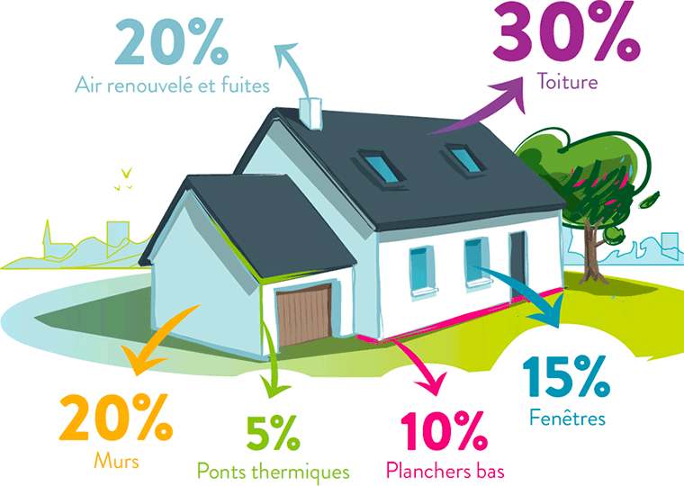
WHICH PROBLEMS ?
HEAT LEAKAGE IN A HOUSE : 30 % BY THE ROOF AND 20 % BY THE WALLS
PROBLEM CAUSED BY MOISTURE LEAKS IN A BUILDING
HIGH COST OF A COMPLETE RENOVATION

Slide 5
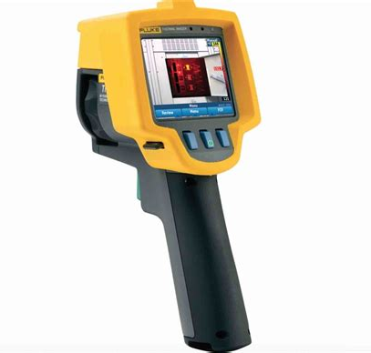
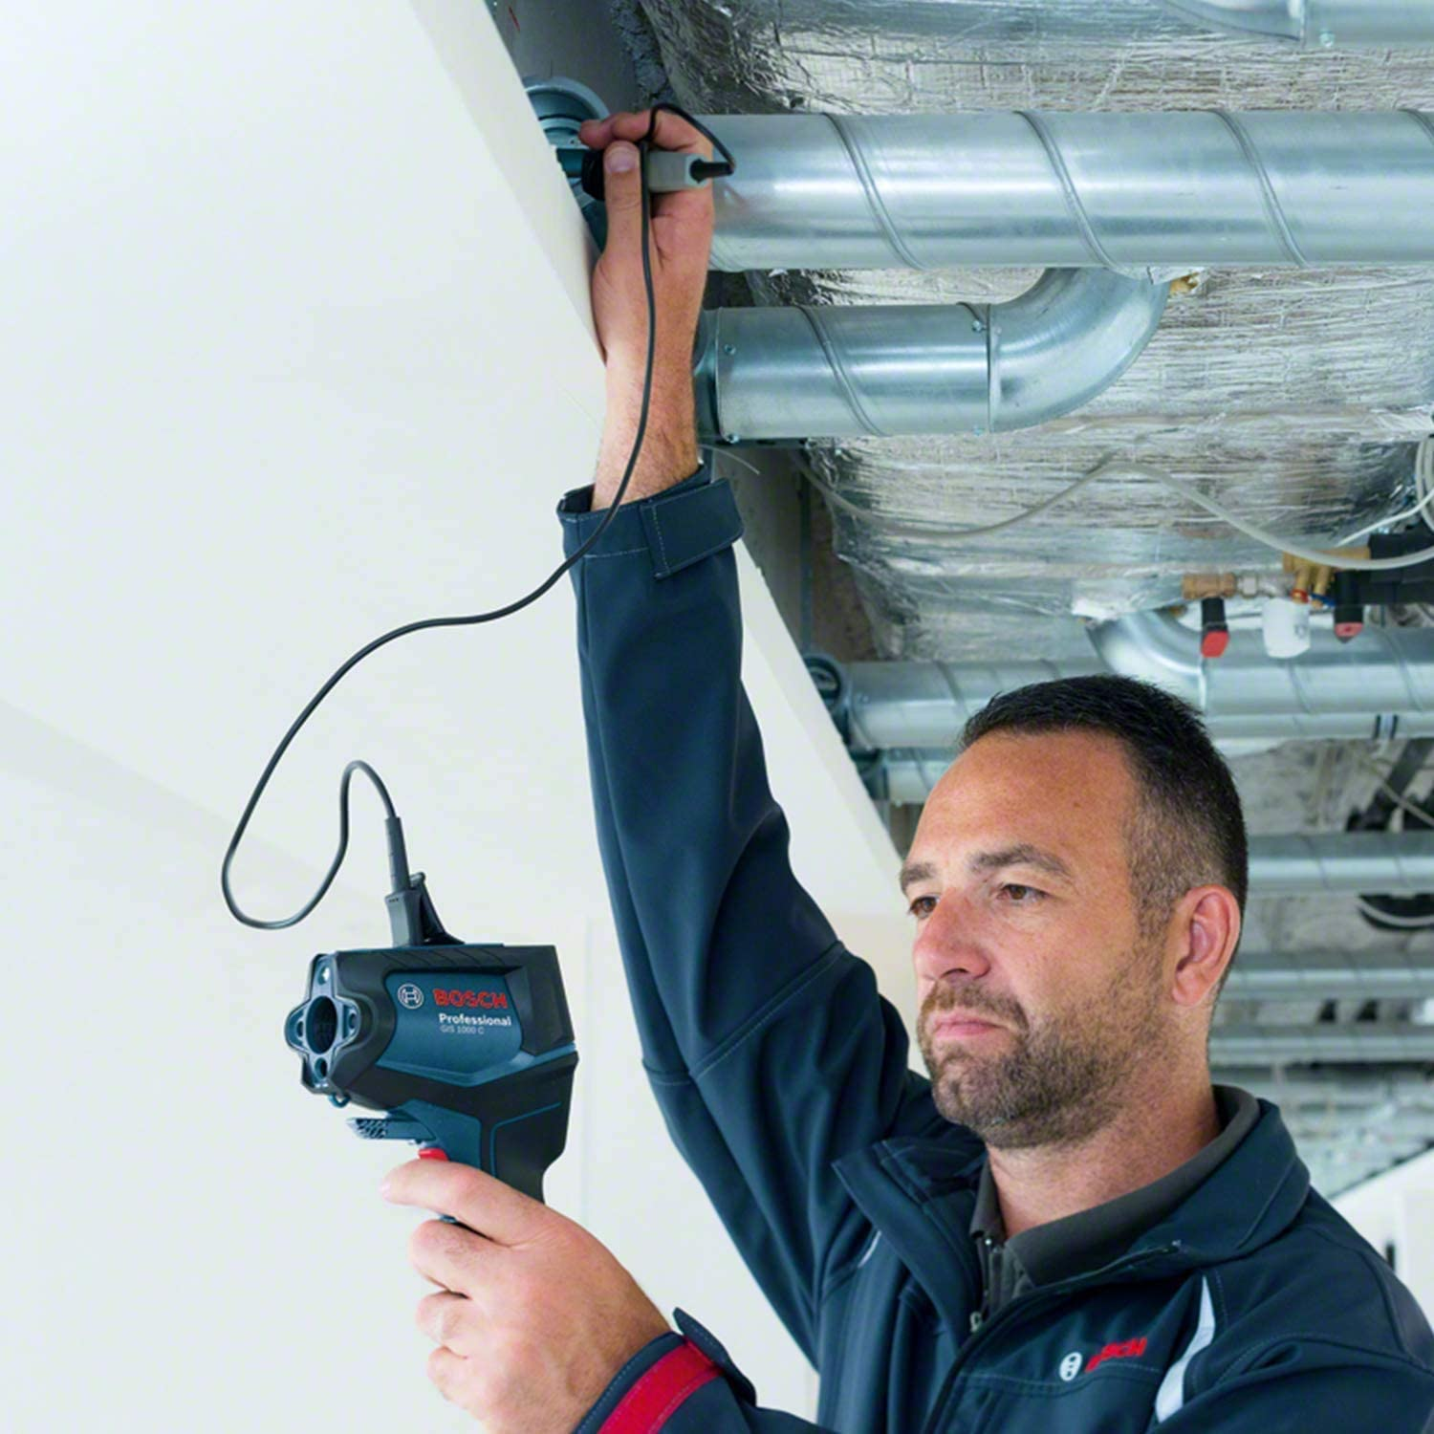
WHICH CURRENT SOLUTIONS ?
THE THERMOGRAPHIC CAMERA :
CAN DETECT VARIATION USING INFRARED RADIATION
VERY EXPENSIVE IF YOU WANT THE PRECISE ANALYSIS OF A COMPLETE WALL
LOSE ACCURACY WHEN USED OUTSIDE, BECAUSE OF THE AIR HEAT VARIATIONS
+
-
-

Slide 6
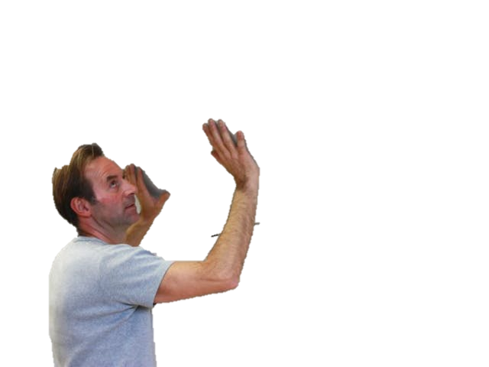
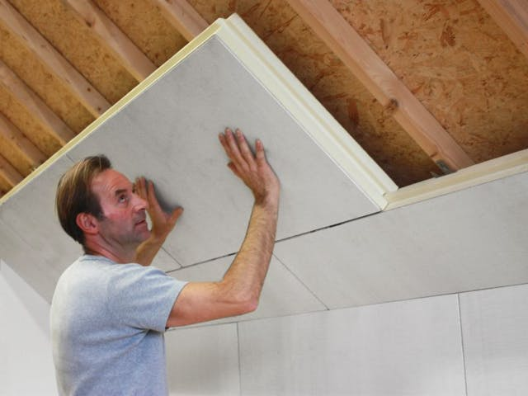
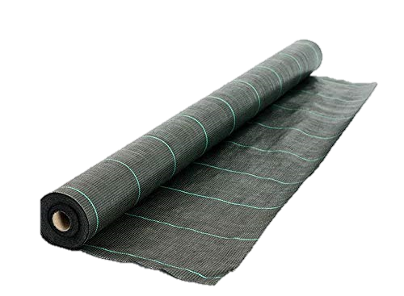
OUR SOLUTION
A GRID OF SENSORS ARRANGED ON A TARPAULIN
VERY SIMPLE TO MOVE ON THE DESIRED SURFACE
MESURE VERY PRECISELY HEAT FLOWS OVER A LARGE AREA
ALSO ALLOWS TO MEASURE MOISTURE LEAKS AND VIBRATIONS OF THE WALL
NOT VERY EXPENSIVE

Slide 7
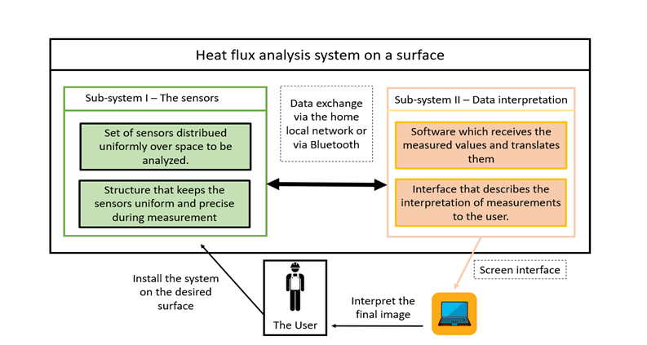
BLOCK DIAGRAM OF OUR SOLUTION

Slide 8

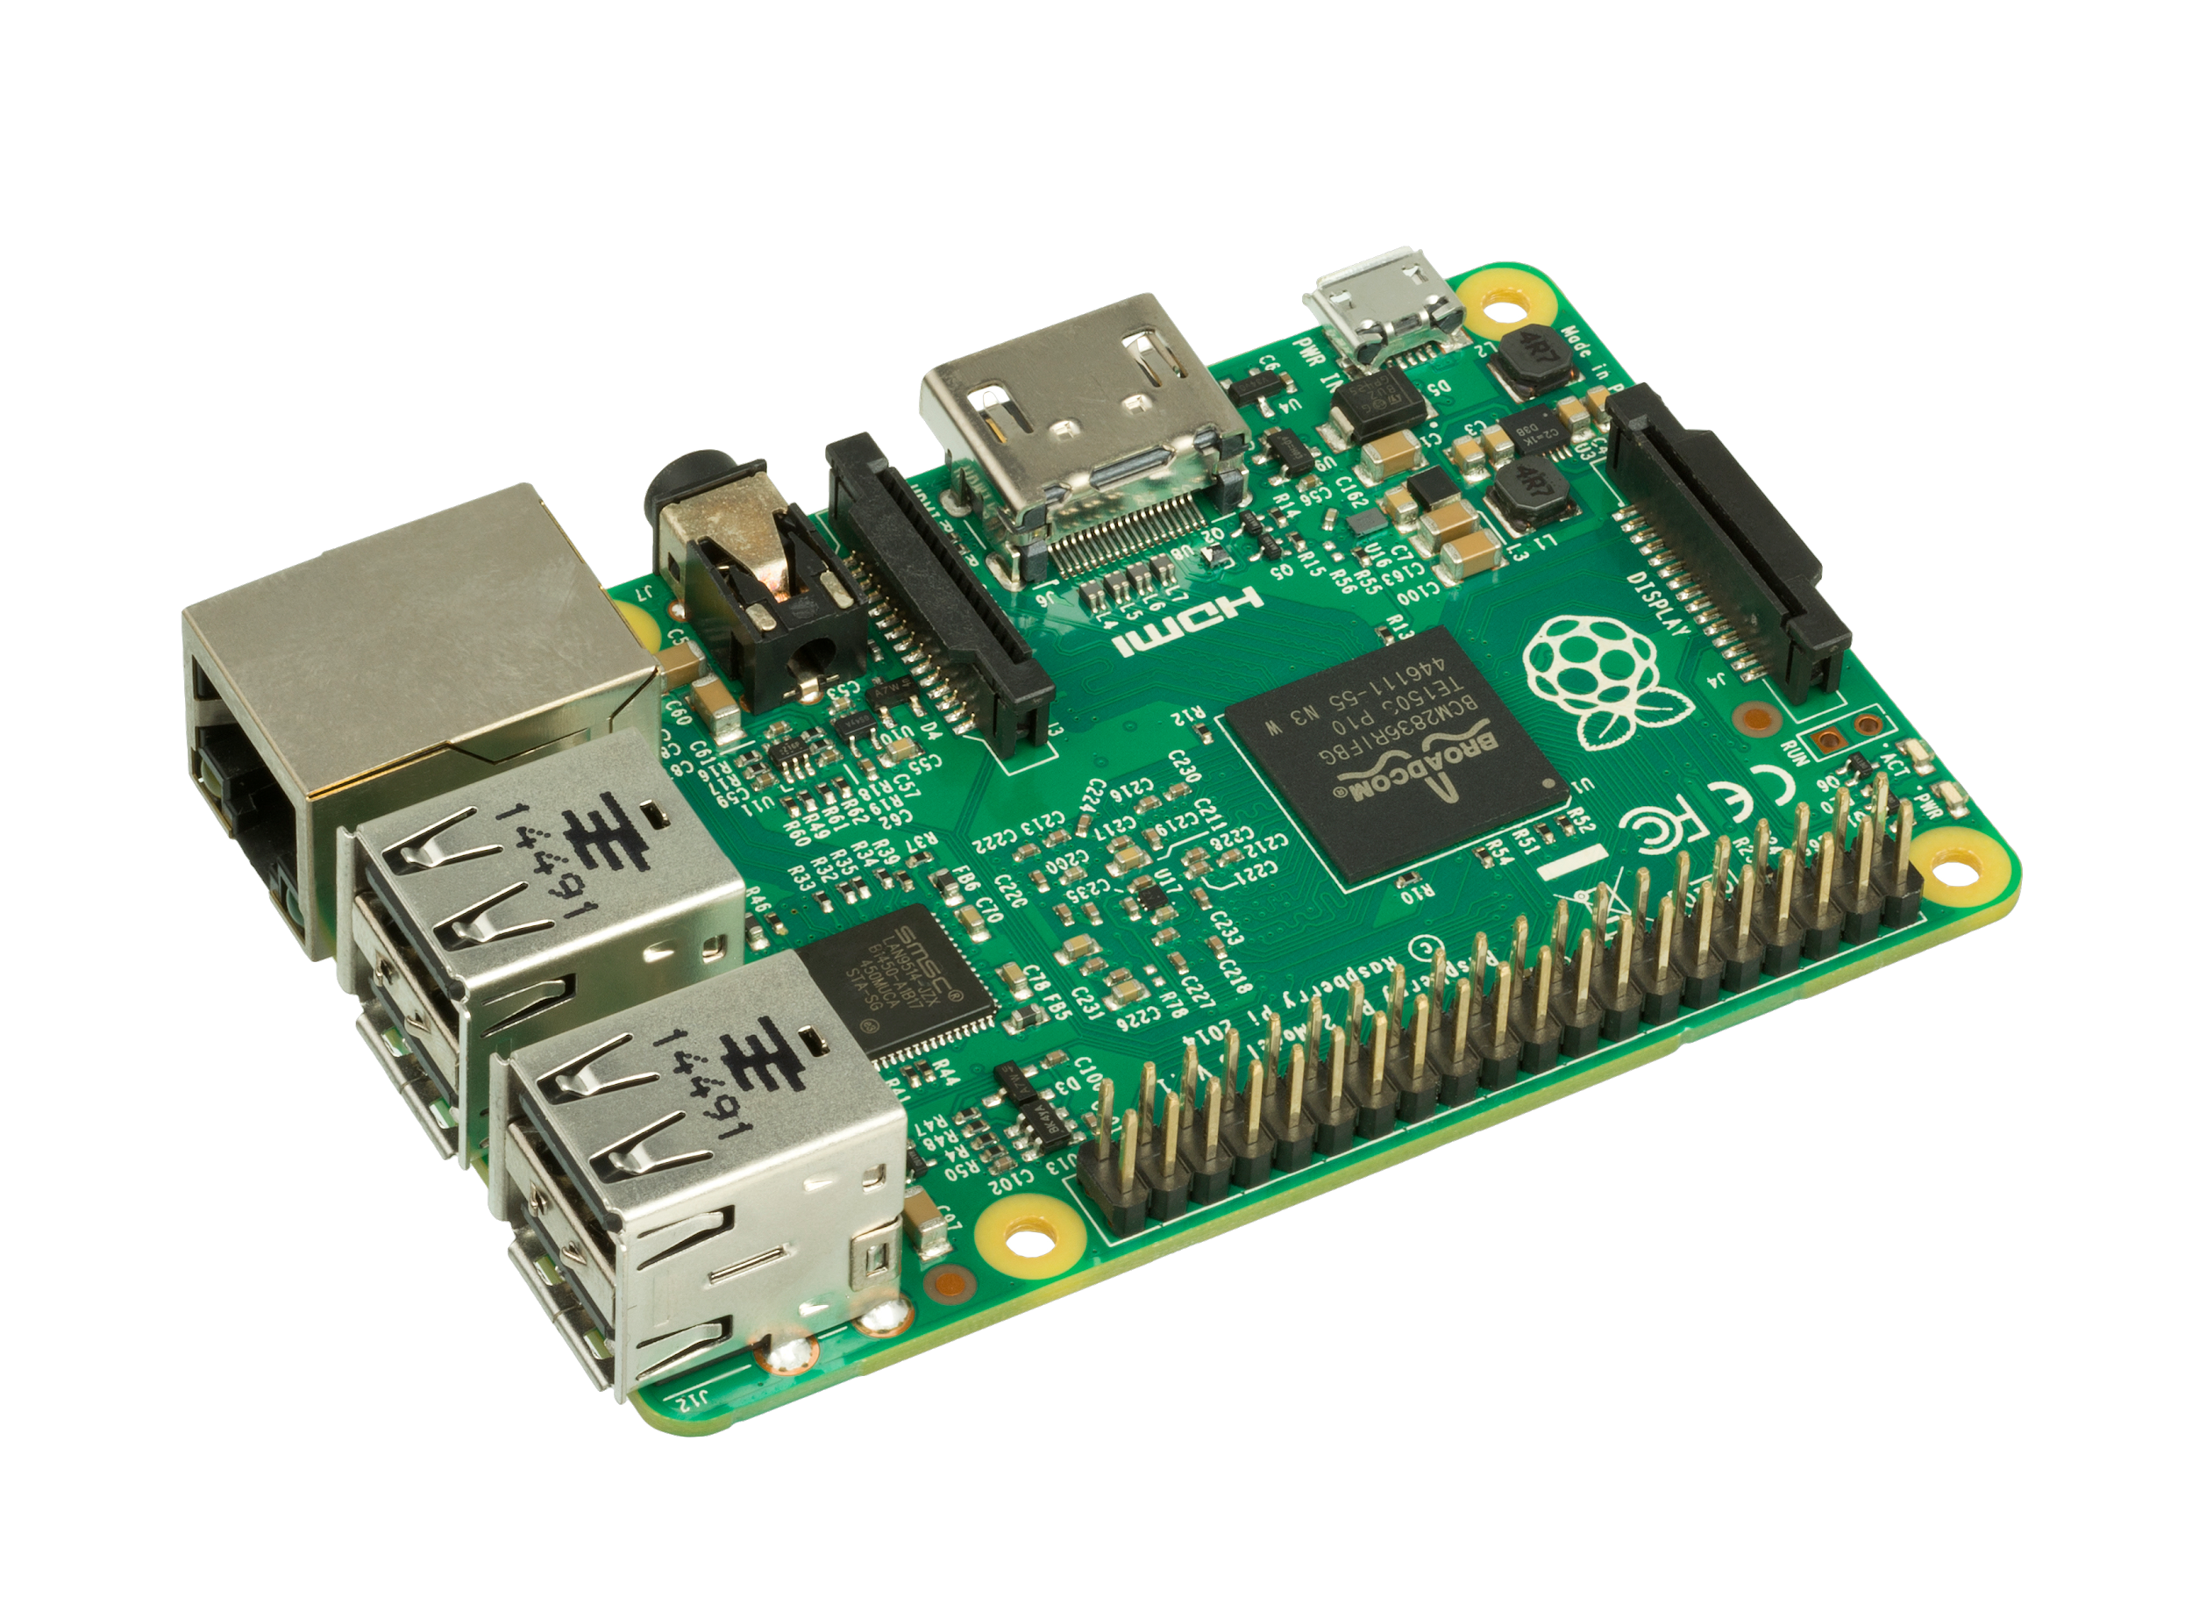
FIRST PROTOTYPE
EQUIPMENT :
RASPBERRYPI
Sensor BME680

Slide 9
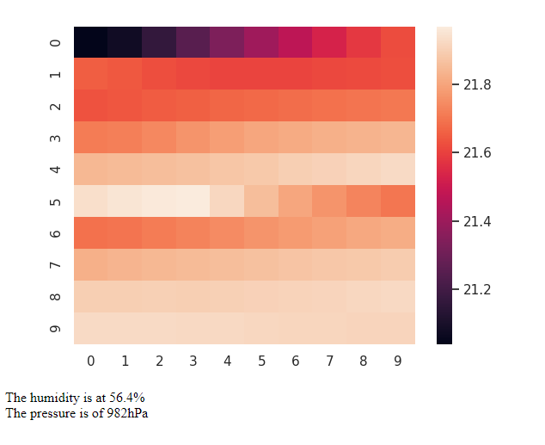
FIRST RESULTS
-WE OBTAIN THE MAP OF TEMPERATURE VARIATIONS ON THE SURFACE OF A WALL, WHICH PERMIT TO SHOWS HEAT FLUXES ON THIS WALL.

Slide 10

TO GO FURTHER…
IMPROVEMENT IDEAS FOR THE DEVELOPMENT OF OUR PROJECT:
IMPROVE THE USER INTERFACE WITH A MOBILE APPLICATION
PERMIT TO ADD MORE SENSORS ON THE TARPAULIN TO BE EVEN MORE PRECISE
THINK ABOUT CAPTURING OTHERS INTERESTING DATA IN THE BUILDING
ETC…

Slide 11

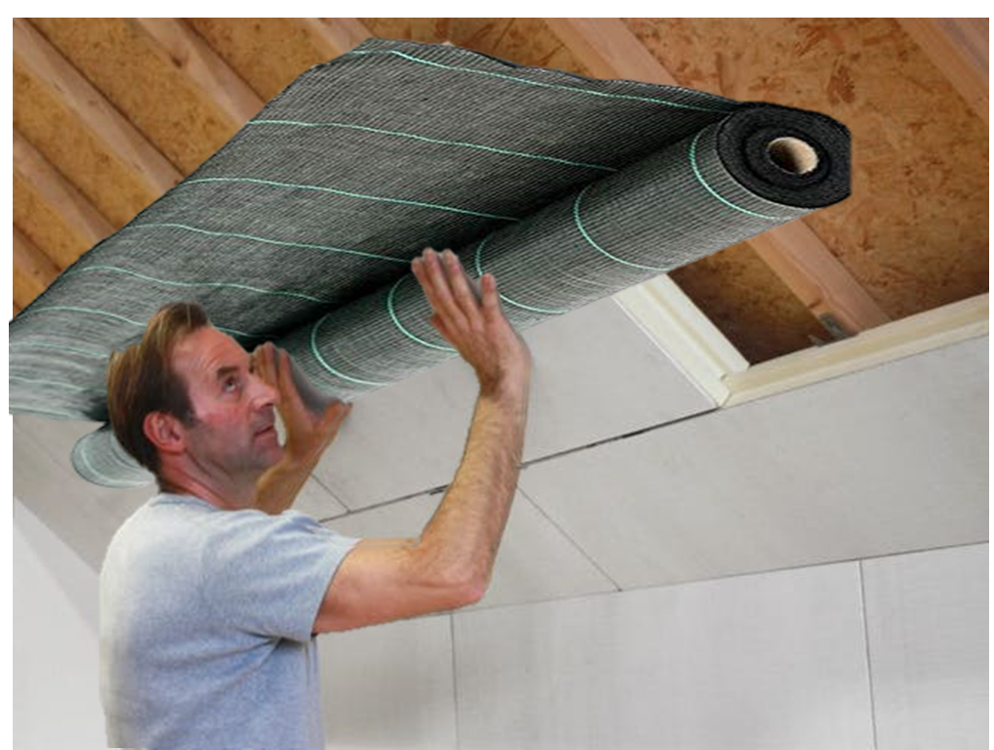
THANK YOU FOR YOUR ATTENTION

